Slide 1
Advancing TTP Analysis: Harnessing the Power of Encoder-Only and Decoder-Only Language Models with Retrieval Augmented Generation
Author: Reza Fayyazi, Rozhina Taghdimi, Shanchieh Jay Yang
Speaker: 曹凱翔

Slide 2
Outline:
Introduction
Related Works
Methodology & Experimental
Results & Discussion
Conclusion

Slide 3
Introduction

Slide 4
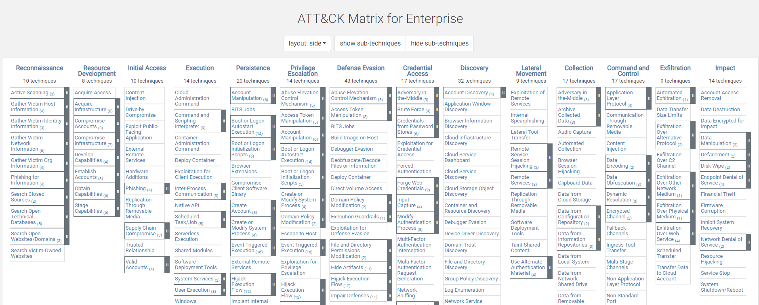
Introduction
Tatics
Technique

Slide 5
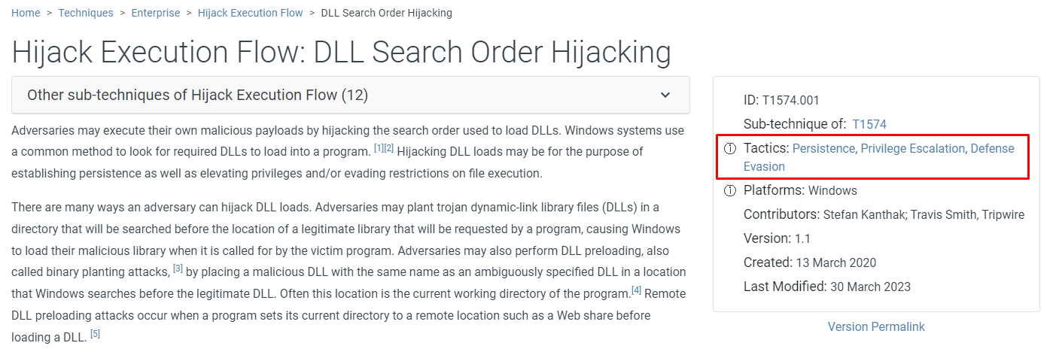
Introduction
More suitable “Execution” ?

Slide 6
Examine three sets of approaches
direct use of the decoder-only LLMs (GPT-3.5-Turbo)
supervised fine-tuning (SFT) of encoder-only LLMs (RoBERTa and SecureBERT) with ATT&CK descriptions
the use of RAG on decoder-only LLMs

Slide 7
LLMs
LLMs are an important advancement in the field of Natural Language Processing (NLP)
Large number of parameters
Wide range of training data
Transformer architecture:encoder and decoder

Slide 8
Encoder-Only Models
BERT: a pre-trained encoder-only LLM based on transformers
RoBERTa: an extended of BERT’s capabilities
SecureBERT:based on RoBERTa but specifically fine-tuned with cybersecurity data

Slide 9
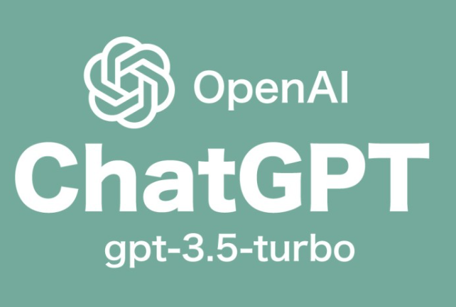
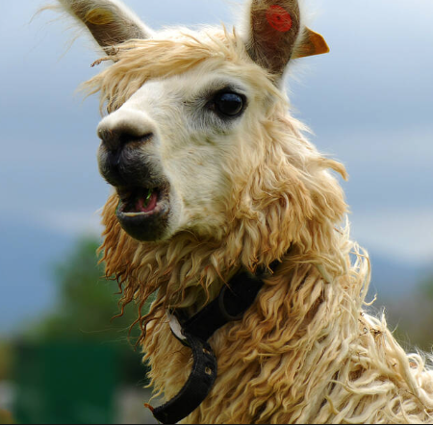
decoder-Only Models
OpenAI’s GPT-3.5
Meta’s LLAMA-23

Slide 10
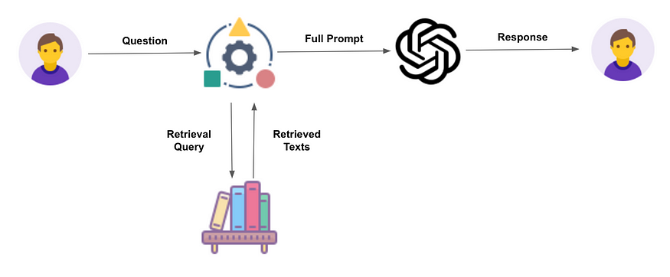
RAG
Combines both Retrieval and Generation technologies.

Slide 11
Related Works

Slide 12
LLM for TTP interpretations
researcher | Research Focus | Methodology | Key Findings
You et al. (2022) | Classifying TTPs using a continuous set of descriptions and SentenceBERT embeddings with TTP-specific features | TIM framework, combining SentenceBERT embeddings and TTP-specific features | Efficiently classify TTPs based on the ATT&CK framework
Alves Filho and Gonçalves (2022) | Testing BERT model variants with different hyperparameter settings to find the best TTP classification model | BERT model variants under hyper-parameter optimization. | Identify the best model
Rani et al. (2023) | TTP Extraction from Unstructured Text Using BERT and RoBERTa Models plus a Linear Classifier | TTPHunter tool, combining BERT/RoBERTa model and linear classifier | Efficiently extract TTP from unstructured text
Orbinato et al. (2022) | Comparing the effectiveness of traditional machine learning and deep learning models in mapping TTPs from cyber threat intelligence text | Experimental study comparing SVM and SecureBERT. | Found SecureBERT to be the most effective in mapping TTPs, without comparing base models.

Slide 13
Methodology & Experimental Design

Slide 14
Study goal
supervised finetuning (SFT) of encoder-only LLMs with labeled ATT&CK technique/sub-technique descriptions
2) direct use of decoder-only LLMs (i.e., pre-trained knowledge)
3) use of RAG for decoder-only LLMs with relevant URLs retrieved by finding the most similar attack procedures.

Slide 15
Challanges
there are no publicly available datasets that map procedure descriptions into ATT&CK tactic(s)
each procedure can map to multiple ATT&CK tactics that LLMs need to consider
a well-structured prompt is needed for LLMs to generate desired outputs
RAG needs to retrieve the most relevant information

Slide 16
Datasets
639 descriptions from the MITRE ATT&CK framework be the label
gathered 9,532 procedure descriptions along with their corresponding URLs

Slide 17
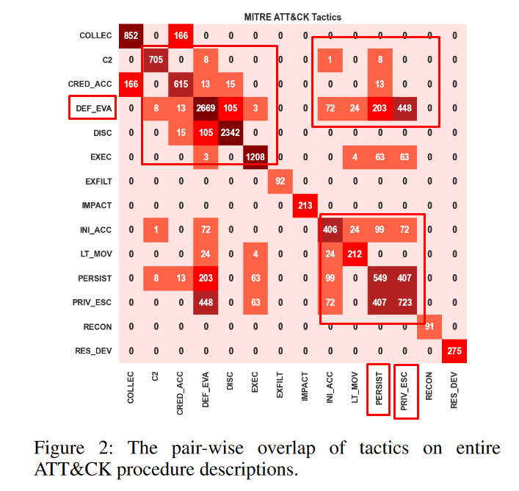
Datasets

Slide 18
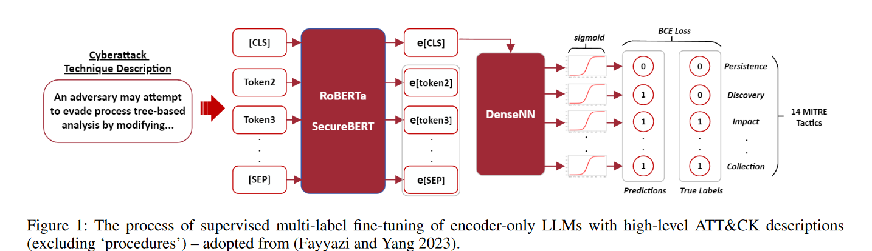
Supervised Fine-Tuning of Encoder-Only LLMs

Slide 19
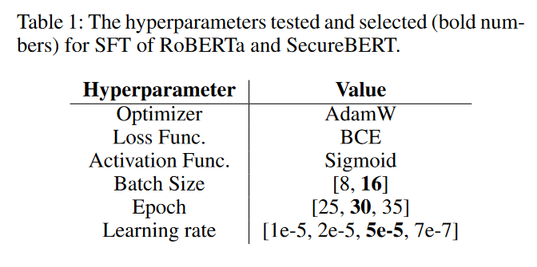
hyperparameters

Slide 20
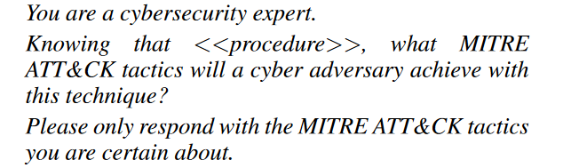
Decoder-Only LLMs w/o RAG
Use OpenAI’s GPT-3.5-turbo-1106 model
temperature parameter to “0”
seed number（1106）

Slide 21
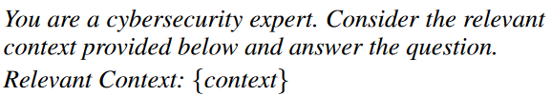
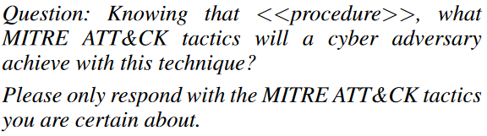
Decoder-Only LLMs with RAG
utilize FAISS5 to find top-3 similar procedures in dataset
3 chunks of 8,000 characters with chunk overlap of 500

Slide 22
Results & Discussion

Slide 23
Evaluation of SFT of Encoder-Only LLMs
fine-tune the encoder-only LLMs (RoBERTa-SFT and SecureBERT-SFT) using the curated MITRE ATT&CK enterprise Tactics, Techniques, and Sub-techniques descriptions
Average F1 score:
SecureBERT:0.54
RoBERTa:0.41
SecureBERT stands for encoder.

Slide 24
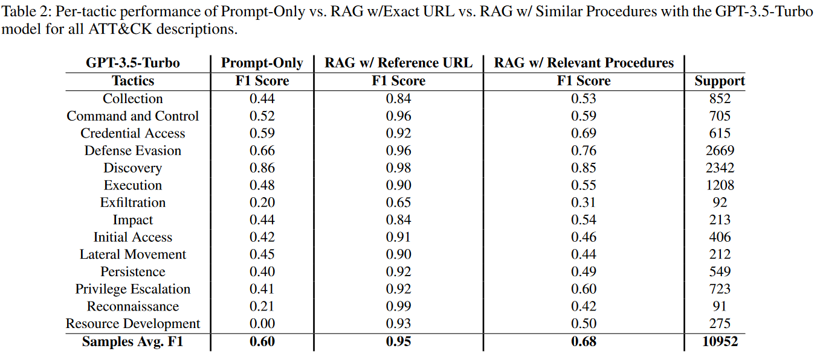
Prompt-Only vs. RAG of GPT-3.5-Turbov

Slide 25
Decoder-Only w/ RAG vs. SFT of Encoder-Only
For Decoder-only with RAG, we separate the 9,532 procedures into two sub-groups:
1) at least one top-3 URL match to the exact URL of the procedure in question
2) no top3 URL matches to the exact URL.

Slide 26
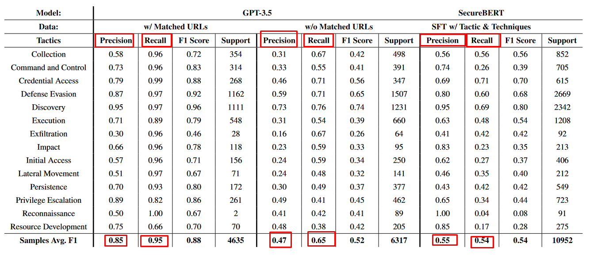
Decoder-Only w/ RAG vs. SFT of Encoder-Only

Slide 27
Specific Examples for Decoder-only w/ RAG
8,543 out of 9,532 descriptions (∼90%), the keywords ‘Tactic:’ or ‘Tactics:’ were in the retrieved chunks
RAG in decoder-only models lacks true capability to ‘interpret’ when provided with additional context, and instead,it just tries to find the best guess

Slide 28
Conclusion

Slide 29
SFT of the small decoder-only language model V.S. RAG-enhanced larger decoder-only LLMs
When supplemented with appropriate RAG inputs, decoder-only LLMs have significant improvement.
demonstrating the limitations of RAG techniques, particularly when they fail to retrieve the most relevant information.
Current decoder-only language models demonstrate high recall rates, but often lack precision.
The study demonstrates the lack of ability of decoder-only language models to 'explain' when providing relevant context by providing concrete examples for analysis.

